Slide 1


Predicting Departures from Raleigh-Durham Airport
Shirley Yueling Li
Data Science Career Track Capstone 2, October 24, 2022

Slide 2
The Problem
Flying is stressful!
Nearly a 1/5 chance of a travel disruption
Can we predict whether a flight will have a delay
(<1 hour, <2 hours,
>2 hours) or be cancelled?

Slide 3
Random Forest multiclass classification model
Yes! We can using our historical data…
• Accuracy: 0.89
• Precision: 0.89
• Recall: 0.89
• F1-Score: 0.89
• ROC-AUC score: 0.96

Slide 4

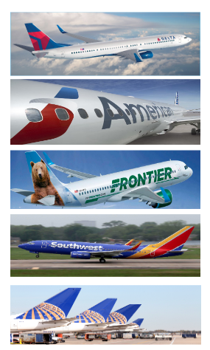

Who cares?
Travellers
Travel agencies
RDU airport and airlines

Slide 5
Data Information
52645
Downloaded from the US Dept of Transportation Bureau of Transportation Statistics
Spans July 2021—June 2022 (the latest available)
Subsetted for RDU departures only
Number of records: 52,645 flights
Number of fields: 33 columns

Slide 6
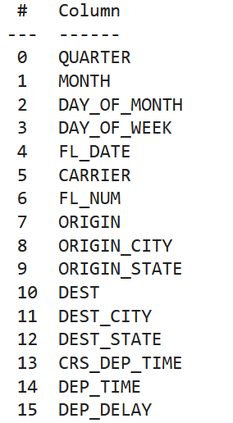
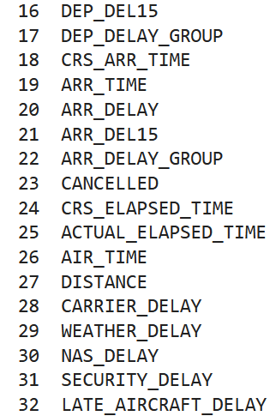
Data Information
52645

Slide 7
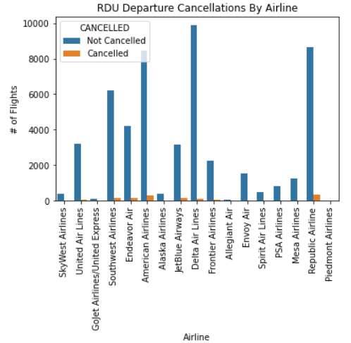
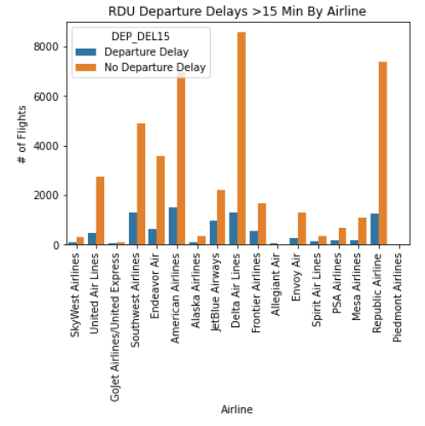
Data Exploration

Slide 8
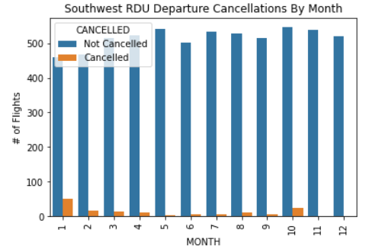
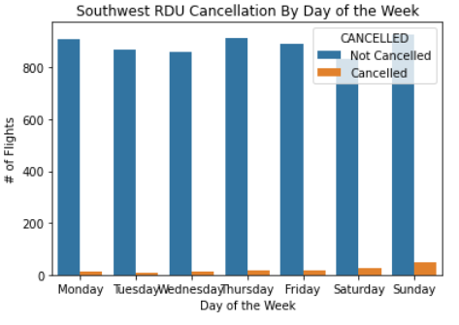
Data Exploration

Slide 9
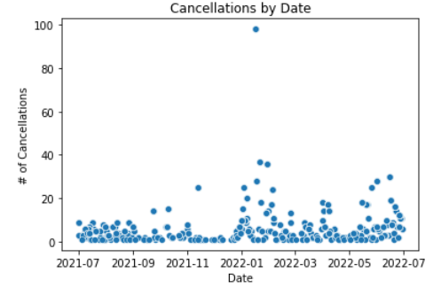
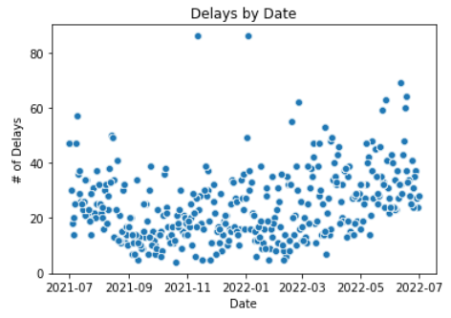
Data Exploration

Slide 10
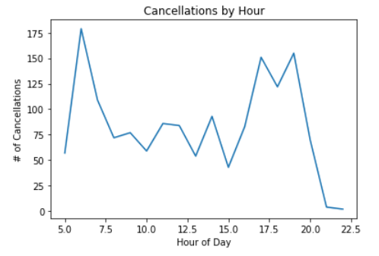
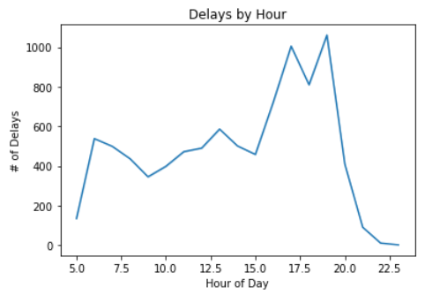
Data Exploration

Slide 11
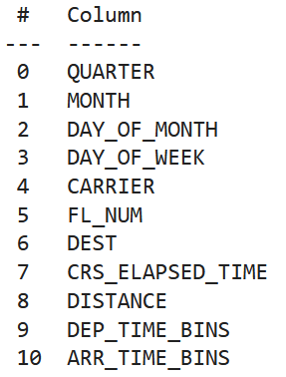
Data Preprocessing: Feature Selection

Slide 12
Data Preprocessing
Resampling
Binning
Dummy variables
Train/test sets
Scaling

Slide 13
Modelling
0. Dummy Classifier
1. KNN Classifier
2. Logistic Regression
3. Random Forest Classifier
4. Gradient Boosting Classifier
5. (SVM Classifier)

Slide 14
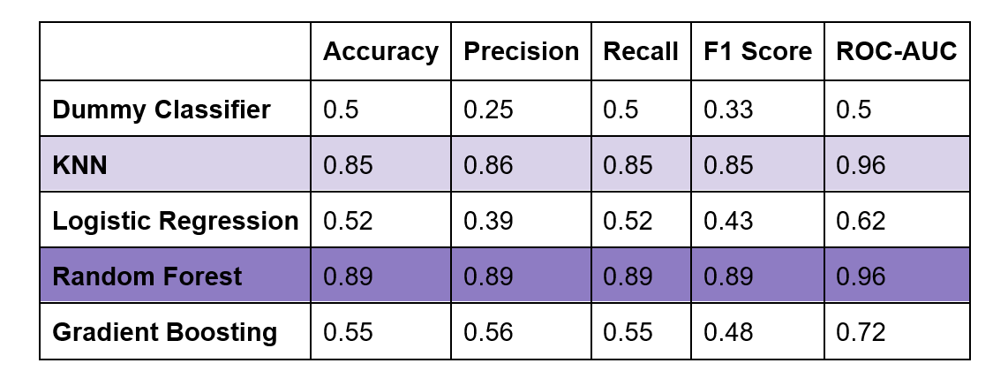
Model Selection

Slide 15
Random Forest Classifier Metrics
Hyperparameters found through a Randomized Search CV:
'n_estimators': 425
'max_features': 'auto’
'criterion': 'gini'

Slide 16
Who cares?
Travellers
Travel agencies
RDU airport and airlines

Slide 17




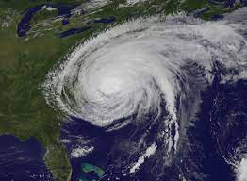
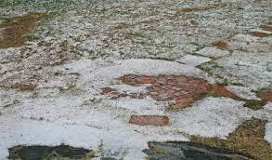
Future research
Thresholding
More Dates/Airports
Adding Features Like Weather Forecast

